Slide 1
Gen AI Based Email Agent
DataDynamos

Slide 2
Team members
Praveen Kumar Kutikuppala
Ashok Babu Dadabadi
Pankaj Tiwari
Siva sankar Vecha
Sidharth Guntoji

Slide 3
Project motto
Problem: Team is monitoring the email box, reads the emails and categorizes them and sends to the different teams by creating relevant data. This included copy paste and date. Extracting suitable data takes time. Manual categorization involved human errors. If there is a bulk of email inflow, there is a chance of missing. Finding the emails thread and follow-up will be another issue.
Solution: Gen AI base email agent that reads emails with(out) Attachments. Sometimes attachments may images/pdf. These are read and converted to text and object is created and filled in CSV file. This CSV file can be used to generate tickets/input for any other script of project.
Benefit: 1000 emails can be categorized by solution in ~9mins. Which takes ~17 human Hours.

Slide 4
Project flow
Sample email data created
Email types -3
Without attachments
With attachments and with PDF
Converted emails to JSON
LLM classify the required details
OCR module to get text from PDF or images
Created Module to read relevant data

Slide 5
Input & output
Input: At this moment we have generated sample data
Enhancement Input: We can create Realtime eml objects from outlook using PowerShell script and store those files in a directory. Project need to run on the directory
Output: Currently creating output to CSV file with below data
Sender, Receiver, request type, sub request type, Payments, account number, principle amount, interest, fee, escalation, appreciation

Slide 6
Technical Requirements
Server requirements:
CPU 49 cores
Memory 250 GB
GPU 24 GB
Llama3.1:8b
This model took 50 mins to run with above configuration.

Slide 7
Software Requirements
Anaconda: Conda Environment
Jupyter notebooks
Ollama
Tesseract

Slide 8
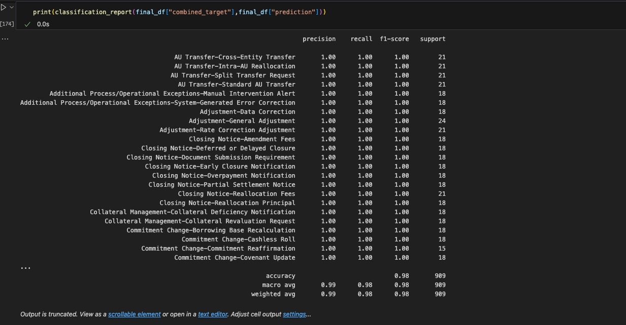
Performance

Slide 9

Question and Answers

Slide 10


